Slide 1

SQL PRESENTATION
BY : CHAHAK NIGAM
SUBMITTED TO :DR. ASHISH SIR

Slide 2
THE PROJECT INCLUDES
QUERIES SOLVED IN SQL
02
DATA VISUALIZATION IN POWER BI
03
DATA STORAGE AND STATISTICS IN EXCEL
01

Slide 3
OBJECTIVE
WITH THE HELP OF THIS DATA WE WILL ANALYSE THE FORMULA ONE RACES THE TOOK PLACE OVER THE YEARS .
ANALYSING THIS DATA WILL HELP US GAIN INSIGHT ON THE COUNTRIES ,DRIVERS ,MANUFACTURES OF CARS THEIR SPEED ,TIME ETC.
THIS DATA WILL BE VERY HELPFUL FOR CARS MANUFACTURES ,THE AUDIENCE ,DRIVERS ,THE COUNTRY HOSTING THE RACE AND THE STAKE HOLDERS

Slide 4
INDEX
SR NO | TOPIC
1 | INTRODUCTION TO DATABASE
2 | SCHEMA DIGRAM
3 | CREATION OF DATA BASE AND TABLES
4 | BUSINESS QUESTIONS
5 | INSIGHTS
6 | KPI
7 | SUMMARY
8 | DASHBOARD
9 | STATISTICS
10 | RECOMMENDATIONS

Slide 5
INTRODUCTION TO DATABASE
THE DATABASE HERE IS ABOUT THE FORMULA 1 RACE . THAT TAKES PLACE EVERY YEAR .IT ALSO HAS VARIOUS TABLES. THE DATA HERE IS CONTAINS RECORDS OF 72 YEARS FROM 1950 TO 2021 .IT HAS VARIOUS TABLES LIKE
CIRCUIT (DETAILS OF TRACKS)
RACE (DETAILS OF RACE)
STATUS (DETAILS OF STATUS OF DRIVER)
DRIVER (PARTICIPANT DRIVING THE CAR)
DRIVER STANDING (RATING OF DRIVER)
CONSTRUCTOR (DETILS OF CAR AND MANUFACTURER)
CONSTRUCTOR RESULT (STANDING OF CONSTRUCTOR)
LAPTIME (TIMING OF LAPS IN EACH RACE)
RESULT (OUTCOME OF THE RACE)

Slide 6
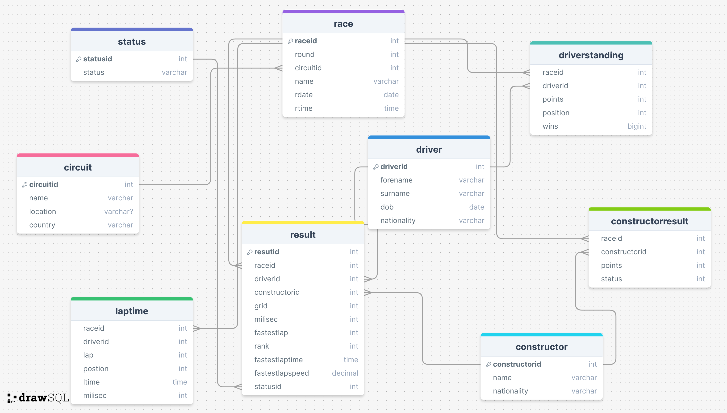
SCHEMA DIGRAM OF THE DATABASE

Slide 7
CREATING TABLES AND INSERTING DATA

Slide 8
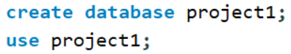
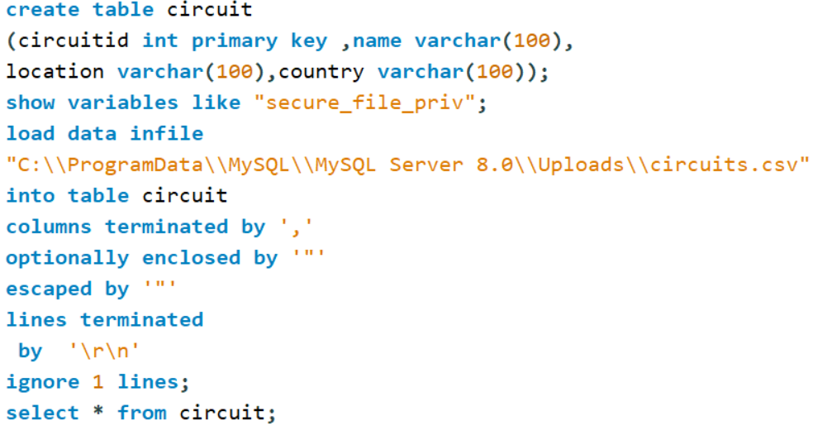
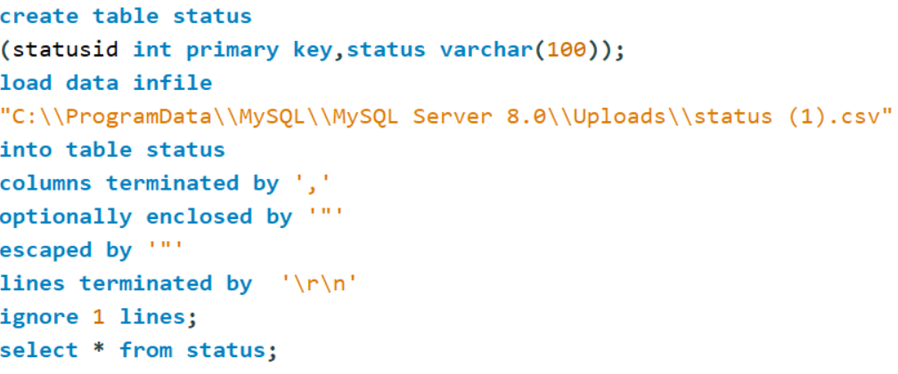
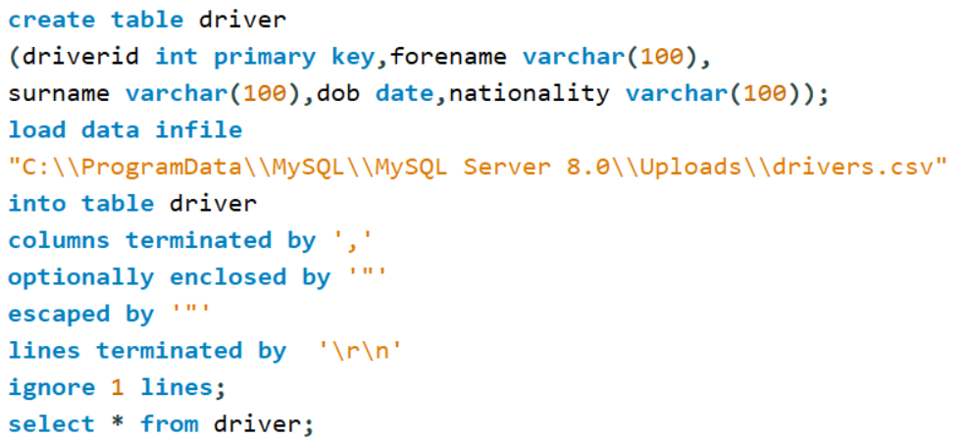
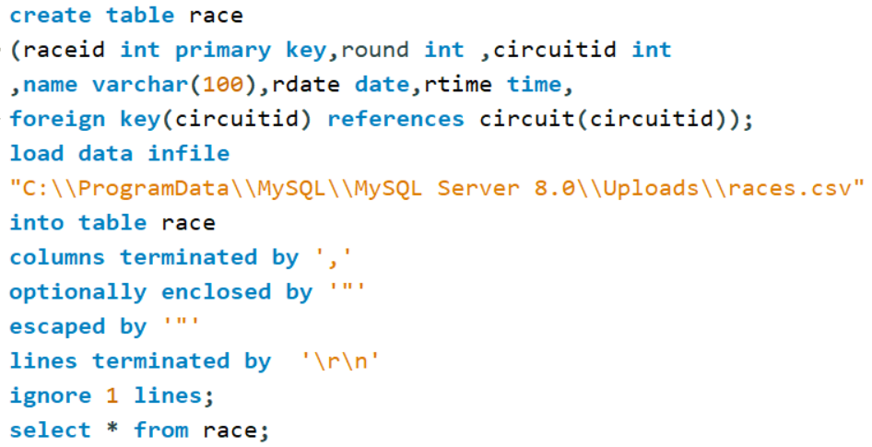

Slide 9
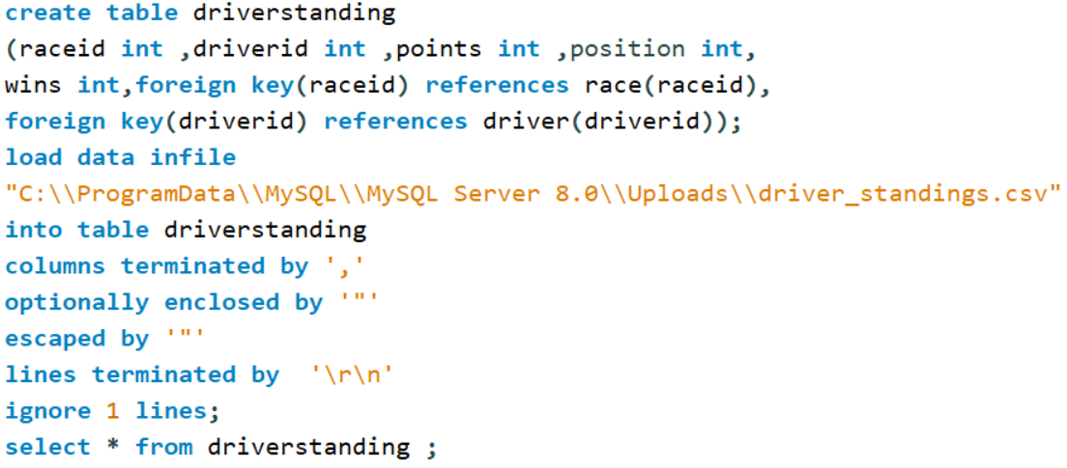
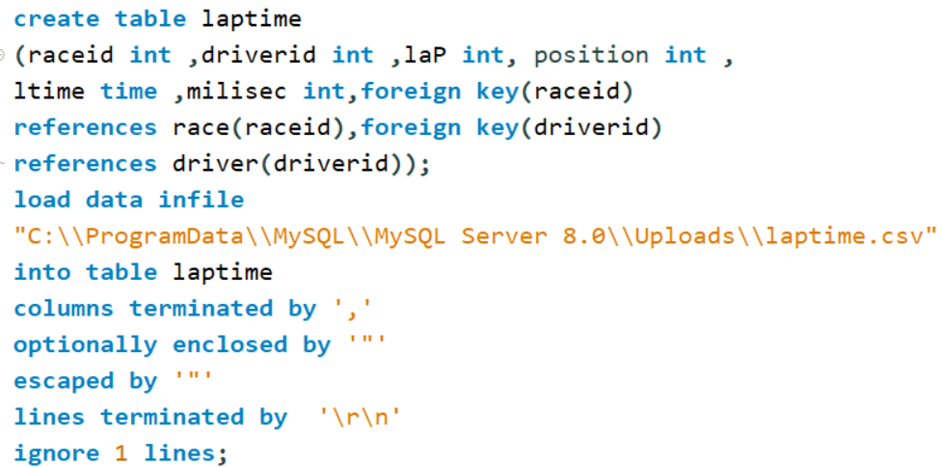
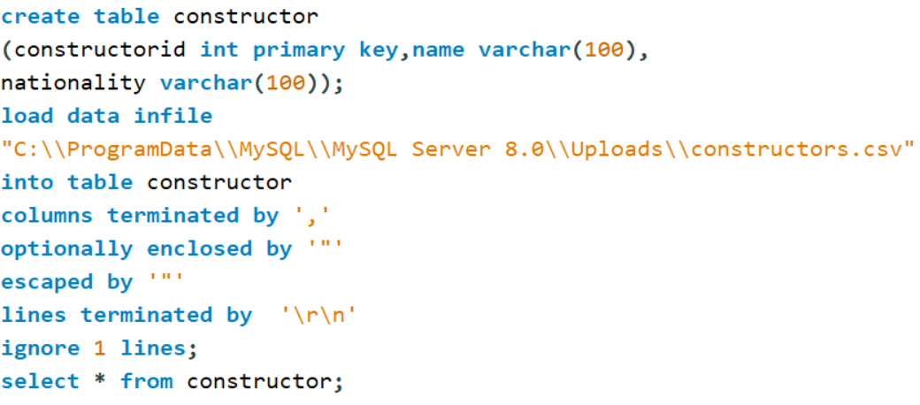
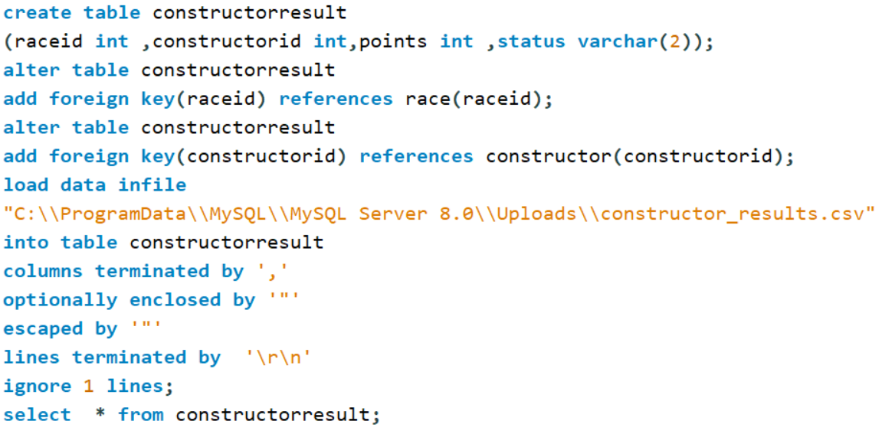

Slide 10
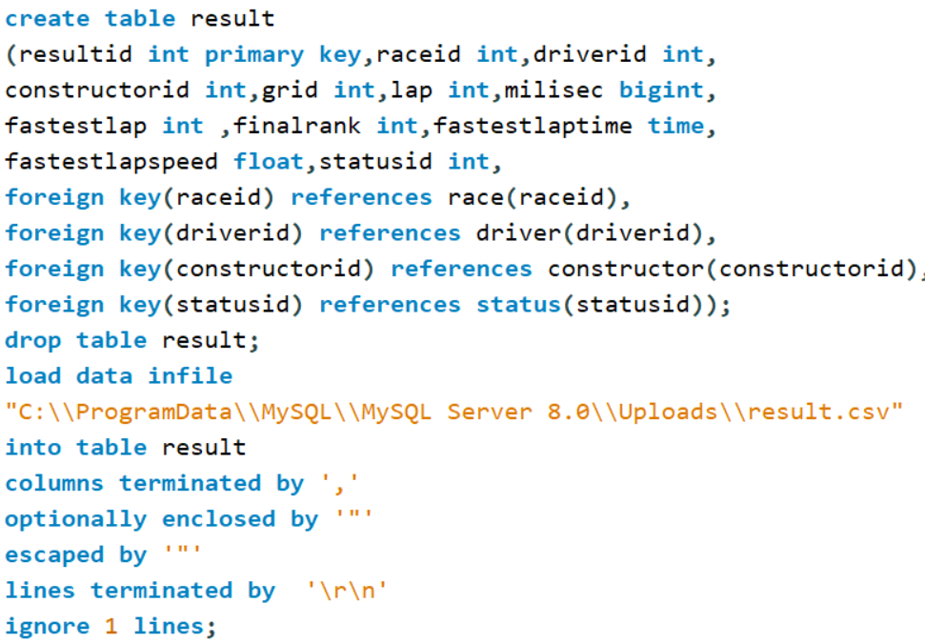

Slide 11
BUSINESS QUESTIONS AND INSIGHTS

Slide 12
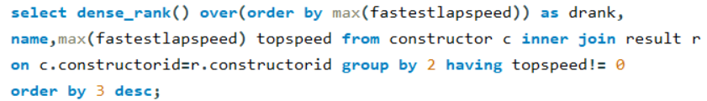
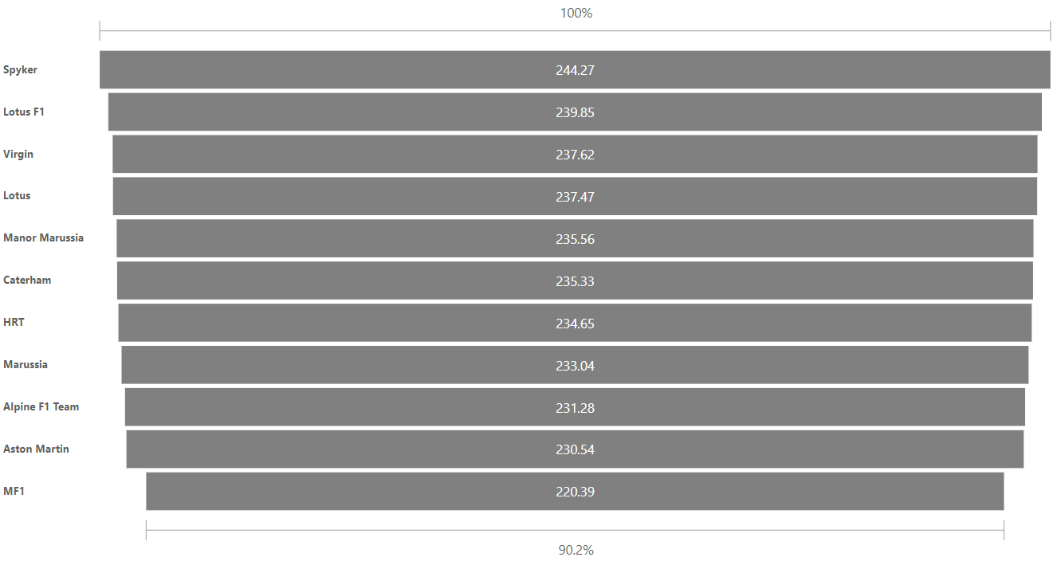
TOP SPEED OF CAR
SQL QUERY
WHICH IS THE FASTEST CAR?
ON SEEING THE GRAPH WE CAN SEE THAT SPYKER IS THE FASTEST CAR WITH THE TOP SPEED OF 244.27.
ON ANALYSING THE CARS WE SEE THAT THERE ISN’T MUCH DIFFERENCE IN THE TOP SPEED SO IF WE ARE LOW IN BUDGET WE MAY CHOOSE A SLOWER CAR WHICH IS IN OUR BUDGET

Slide 13
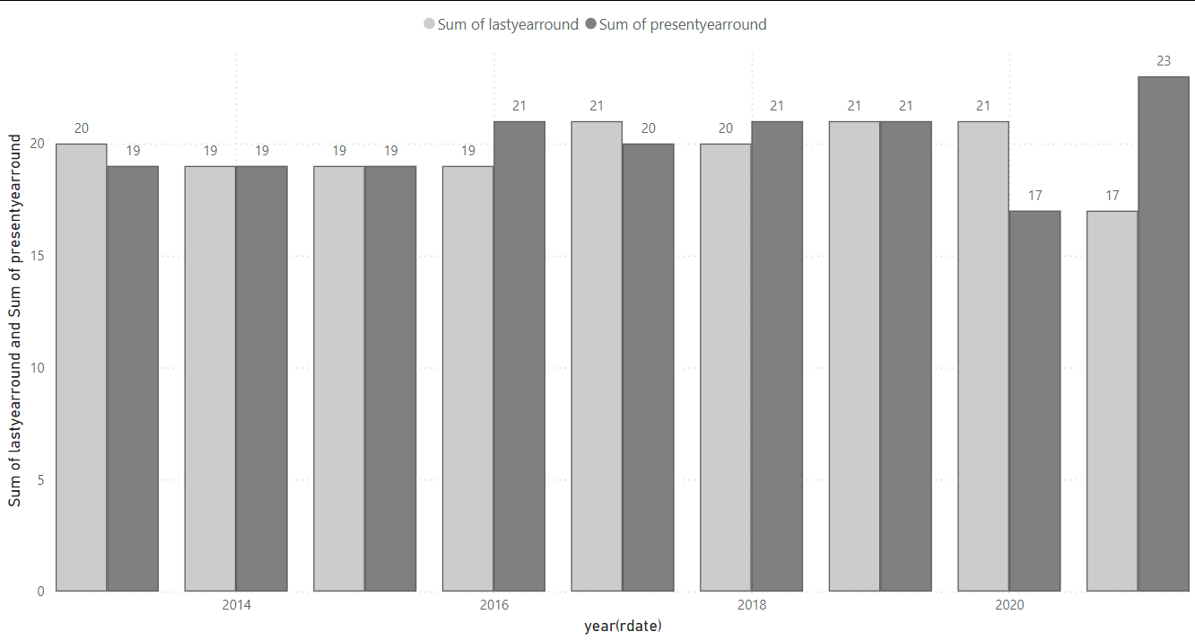
NUMBER OF ROUNDS
HOW MANY ROUNDS SHOULD BE CONDUCED ?
BY OBSERVING THE TRENDS OF RECENT YEARS WE CAN SAY THAT 18-20 ROUNDS ARE COUNDUCTED SO BY OBSERVING THE NUMBER OF PERTICIENTS WE CAN COUNDUCT THE ROUNDS ACCORDINGLY.AS LARGE AMOUNT OF FUNDING ID REQUIED FOR CONDUCTING A SINGLE RACE HENCE A CLOSE EYE SHOULD BE KEPT AT THE BUDGET TOO WHILE DECIDING THE NUMBER OF ROUNDS.

Slide 14
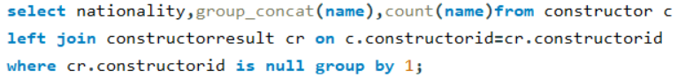
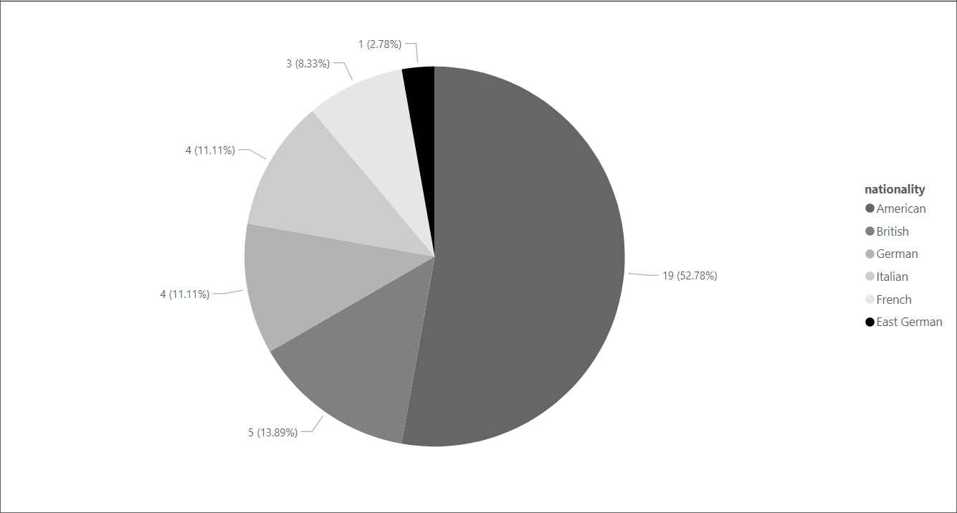
UNUSED CARS
WHICH COUNTRY HAS THE MOST UNSOLD CARS?
PRODUCTION OF UNSED CARS CAN BE A MAJOR LOSS TO A COUNTRY AND THE COMPANY AS THESE CARS ARE VERY EXPENSIVE AND A DROP IN ITS SALES CAN BE A HARM TO ITS BUSINESS AS WELL AS THE REPUTATION OF THE COUNTRY
FROM THE GRAPH WE CAN CONCLUDE THAT AMARICAN CARS ARE THE LEAST BOUGHT WHICH CAN BE SEEN AS A MOJOR LOSS. ALSO AS A PARTICIPENT WE WOULD AVOID AMARICAN CARS

Slide 15
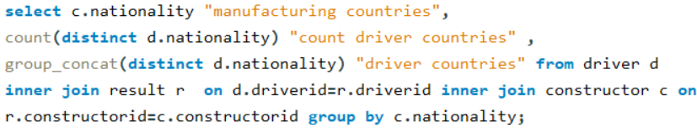
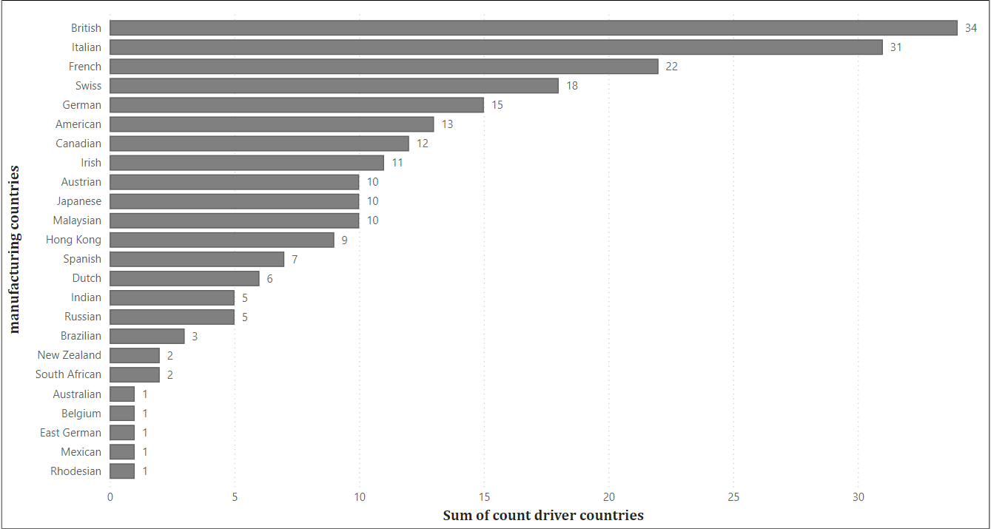
EXPORT OF CARS
WHICH COUNTRY EXPORTS MOST NUMBER OF CARS?
CAR EXPORTING IS A MAJOR BUSINESS AS THE COUNTRY WHICH EXPORST MORE CARS IS BOUND TO MAKE MORE PROFIT
FROM THIS WE CAN SEE THAT BRITAIN EXPORTS THE MOST CARS AS A PARTICIPANT WE WILL ALSO PREFER TO BUY A BRITISH CAR ,BRITAIN ALSO HAS SOME UNSOLD CARS THEY CAN WORK ON THEM

Slide 16
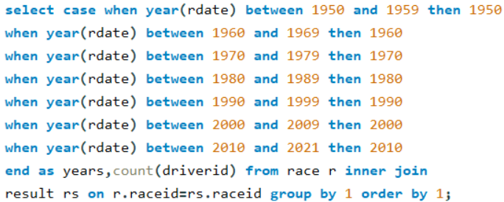
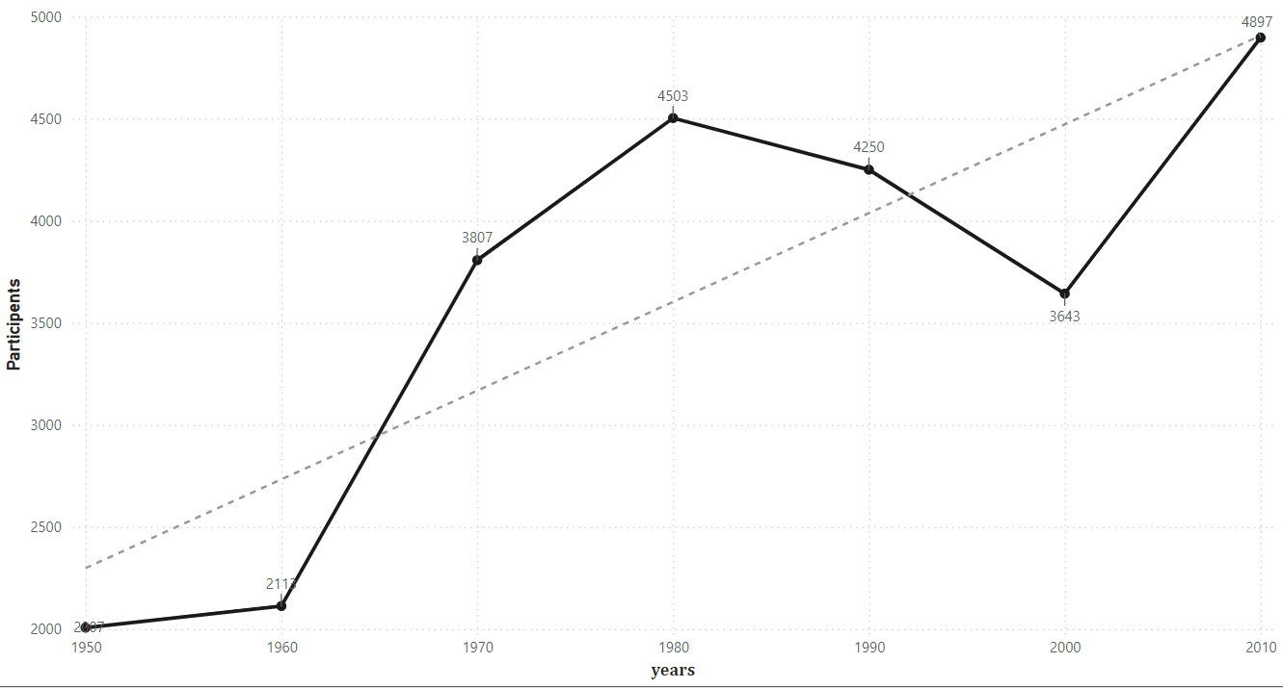
DECADE AND PARTICIPATION
WHAT IS THE DECADE VICE PARTICIPANTION ?
FOR ANY INTERNATIONAL COMPETITON LARGE AMOUNT OF FUNDING IS REQUIRED FOR WHICH PARTICIPATION IS VERY ESSENTIAL
FROM THE GRAPH WE MAY NOTE THAT THERE WAS A MAJOR DECREASE IN PARTICIPATION IN 2000’S THE DRAWBACKS WERE HOWEVER COVERD AND PARTICIPATION INCREASED AGAIN. AND WE SHOULD KEEP WORKING TO INCREASE THE PARTICIPANTION

Slide 17
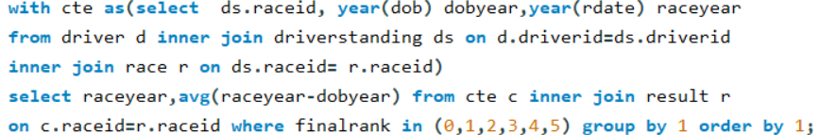
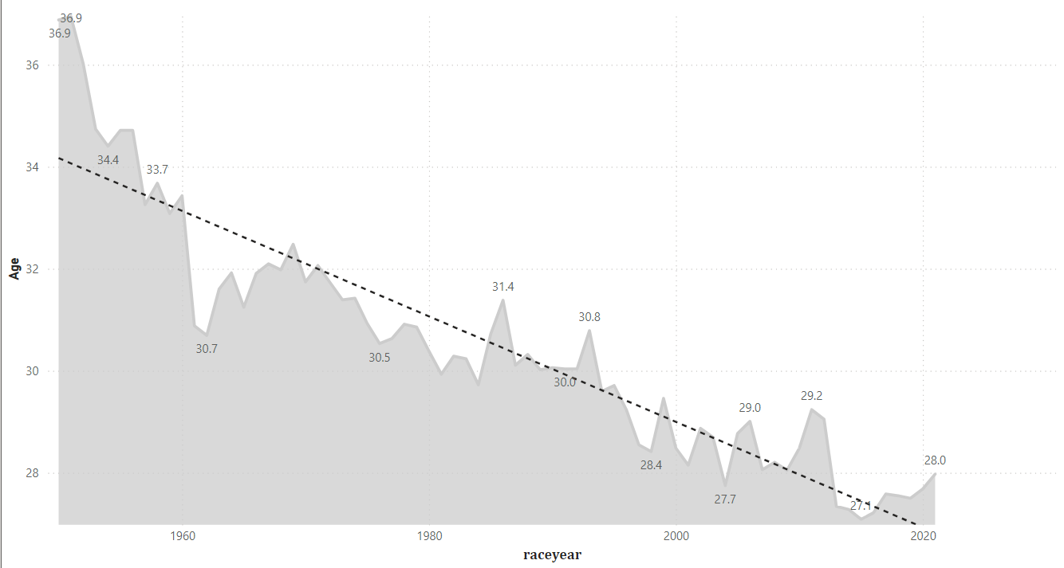
AVERAGE AGE OF DRIVERS
WHAT IS THE AVERAGE AGE OF DRIVER?
AS A PARTICIPENT WE NEED TO KEEP AN EYE ON AVERAGE AGE OF DRIVERS SO WE CAN REGISTER IN THE RACES ON TIME
FROM THE GRAPH WE CAN ANALYSE THAT THE AVERAGE AGE OF DRIVERS HAS DECREASED OVER THE YEARS HENCE WE CAN SAY YOUNG PEOPLE ARE MORE ENTHUISASTIC ABOUT THE RACES. AND THE COUNTRY ALSO GIVES PREFERENCE TO YOUNG BLOOD FOR THIS GAME

Slide 18
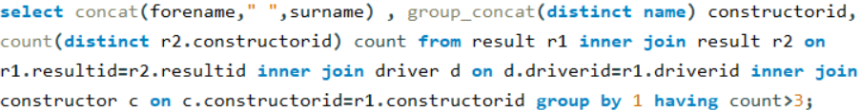
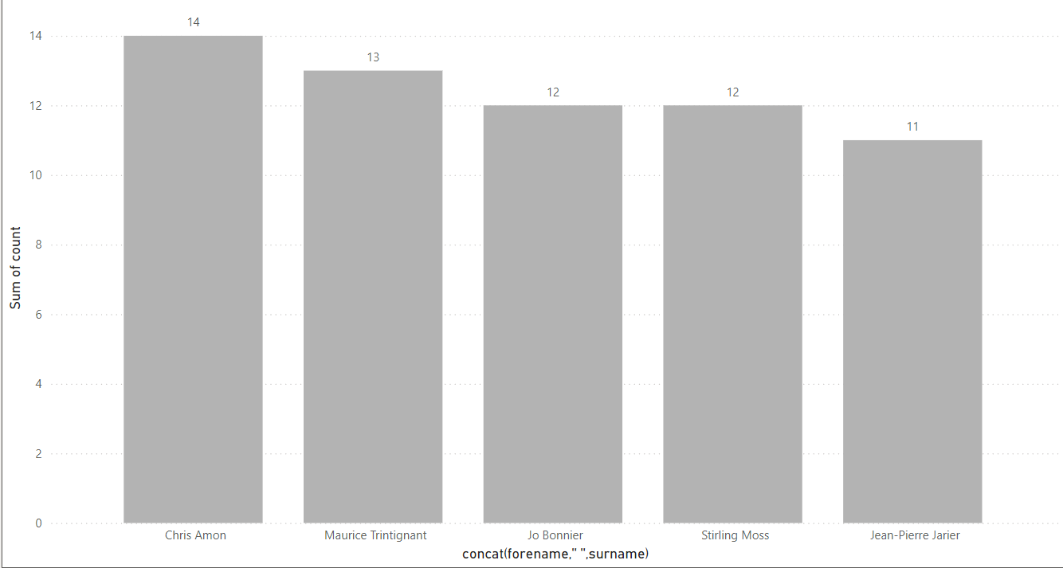
CARS USED BY DRIVERS
DO DRIVERS CHANGE THEIR CARS FREQUENTLY?
THE DRIVERS MOST OF THE TIME KEEP CHANGING THE CARS SO THAT THEY CAN EXPERIENCE DIFFERENT CARS .
AS THE DRIVER CHANGES CARS FREQUENTLY WHICH MEANS RELESING CARS FREQUENTLY CAN BE VERY PROFITABLE

Slide 19
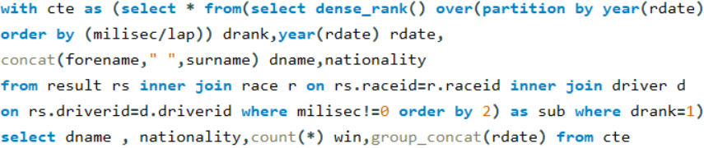
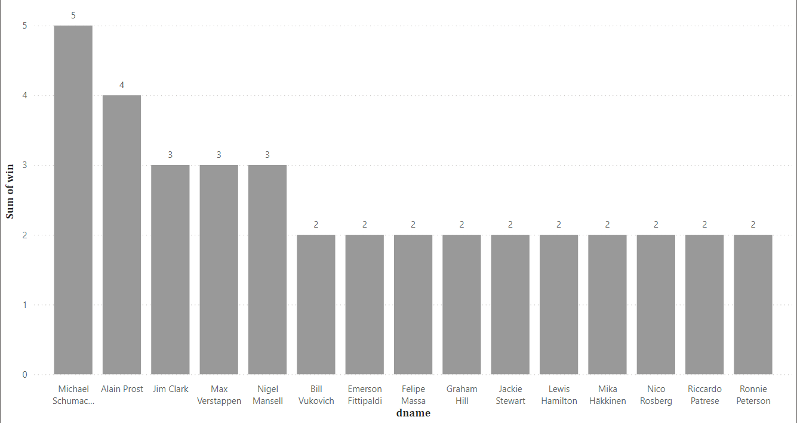
MOST WINNING DRIVER
WHICH DRIVER HAS GRABBED THE 1ST RANK MOST NUMBER OF TIMES?
THE DRIVERS CAN COMPETE IN RACE MORE THAN ONCE SO WE CAN ANALYSE THE MOST WINNING DRIVER
THE MOST WINNIG DRIVER CAN BE A VERY IMPORTANT ASSET AS THEY ARE POPULAR AND CAN BE VERY USEFUL IN ADVERTISING AND IT MAY ALSO BE PROFITABLE TO PUT MONEY ON THEM

Slide 20
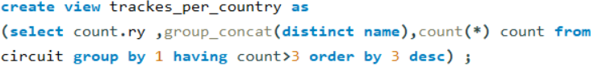
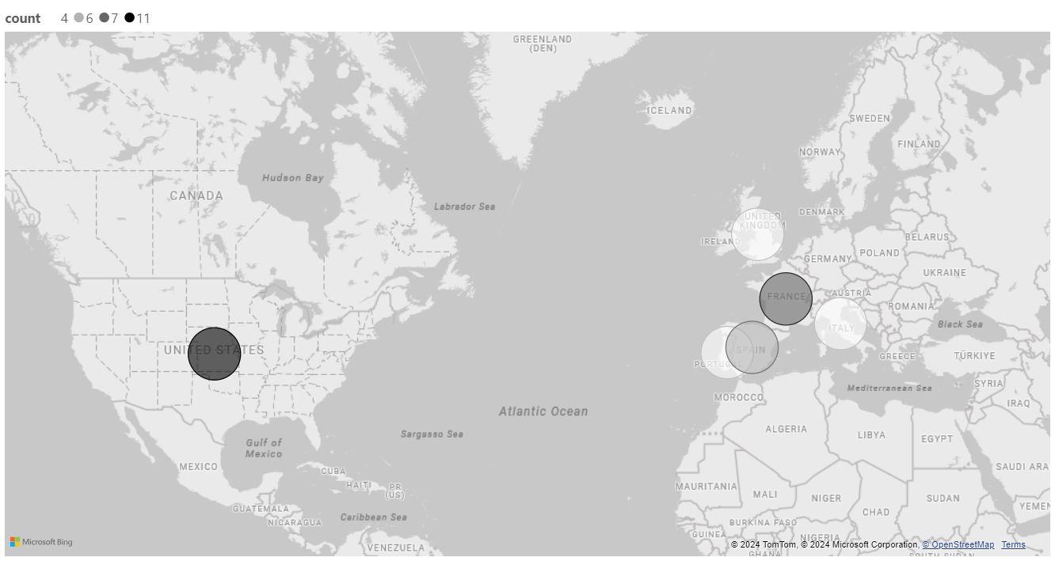
TRACKS IN COUNTRY
WHICH COUNTRY HAS MOST NUMBER OF TRACKES?
BY ANALYSING WHICH COUNTRY HAS THE MOST NUMBER OF TRACKS WE CAN SET UP THE COUNSTUCTION BUSINESS OF TACKES . AS USA ALREADY HAS MANY TRACKS WE CAN AVOID SETTING MORE TRACKES THERE. ALSO AS A PARTICITANT WE CAN PRATICE THERE WITH THE PREMISSION OF THE CONCERNED AUTHORITY

Slide 21
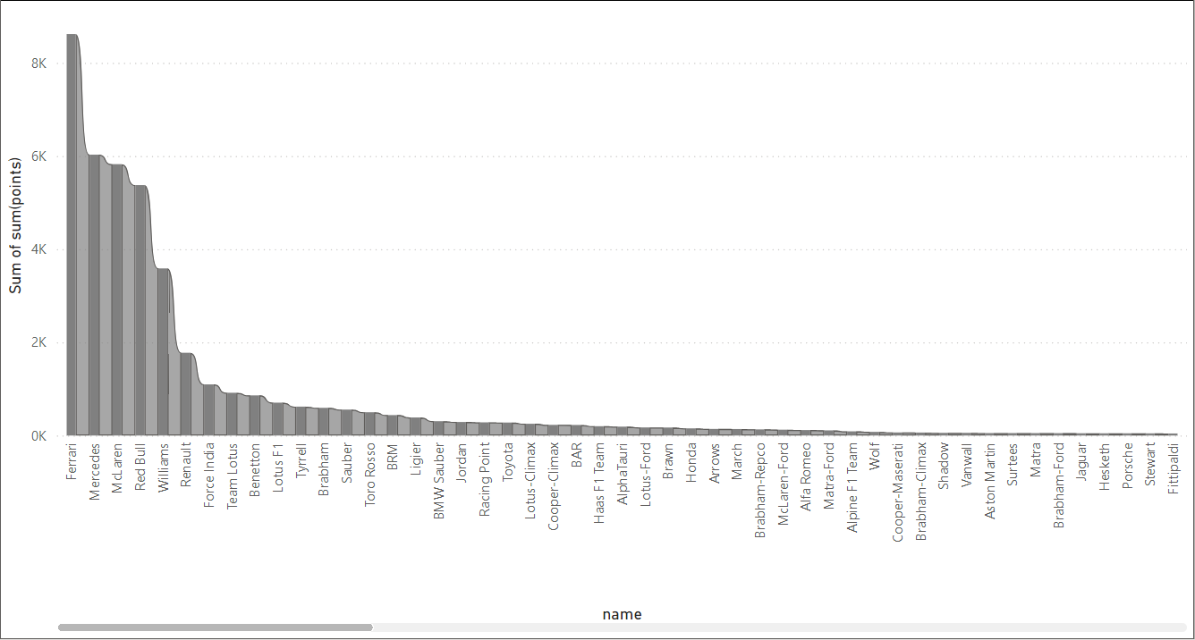
CAR WITH MOST POINTS
AS A PARTICIPENT WE WILL PREFER THE CAR WHICH HAS THE MOST POINTS OR WHICH IS HIGHLY RATED SO OUR CHANCES TO WIN THE RACE INCREASE
AS WE CAN SEE FROM THE GRAPH THAT FARRARI HAS THE MOST POINTS WHICH MEANS THIS COMPANY IS HIGHLY IN PROFIT AND CAN RELEASE NEW MODLES

Slide 22
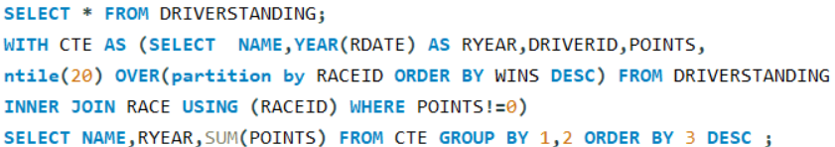
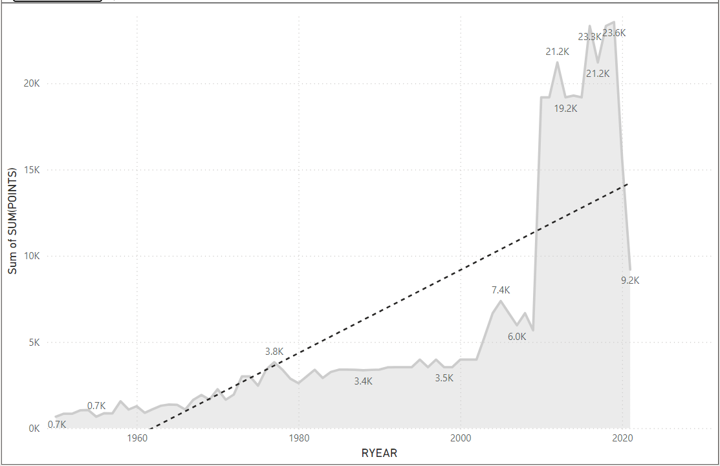
YEAR VICE POINT DISTRIBUTION
IN WHICH YEAR MOST POINTS ARE DISTRIBUTED?
THE YEAR IN WHICH MORE POINTS ARE DISTRIBUTED ARE BOUND TO BE MORE POPULAR
WE CAN SEE THAT THE POINT DISTRIBUTION IS GREATLY INCREASED IN THE RECENT YEARS BUT HAD A SUDDEN DOWNFALL AND WE MUST OVERVOME THAT TO KEEP INCREASING THE REVENUE FROM THE RACE

Slide 23
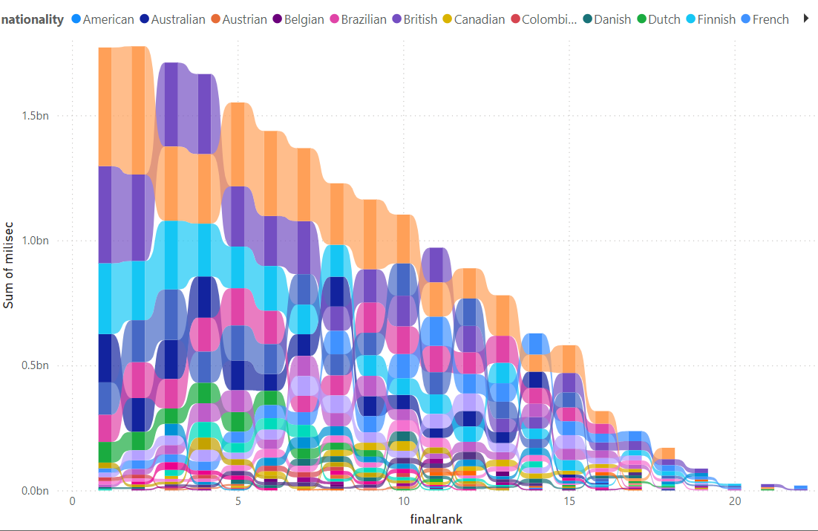
MILLISECOND BY RANK
WHAT IS THE AVERAGE TIME BY WHICH EACH NATION HAS COMPLETED THE RACE?
FORM THE GRAPH WE CAN CLEARLY SEE THAT WHEN AUSTRIANS COMPLETE THE RACE IN 1ST RANK THEY TAKE THE MOST TIME . THE DRIVERS SHOULD WORK ON THEIR TIMINGS SO THEY CAN BREAK VARIOUS RECORDS SET BY OTHER COUNTRIES

Slide 24
INSIGHTS
THE COUNTRY WITH THE HIGHEST ECONOMY IN CARS IS BRITAIN,WHICH REFFERS THAT CAR BUSINESS IN BRITAIN IS VERY POPULAR AND PROFITABLE
FARRARI HAS THE MOST POINTS BUT IS TOP SPEED IS NOT MUCH HIGH , SO IF A PARTICIPANT WANTS TO BUY A CAR HE SHOULD CHECK BOTH TOP SPEED AND POINTS
USA HAS THE MOST NUMBER OF RACING TRACKS BUT MOST NUMBER OF RACES ARE CONDUCTED IN ITALY WHICH MAY INDICATE THAT THE CIRCUITS OF ITALY ARE MORE WELL MANAGED AND THE PEOPLE THERE ARE MORE ENTHUSIATIC ABOUT THIS GAME
THE DRIVERS ACTIVELY CHANGE THEIR CARS HENCE ANY COMPANY SHOULD ACTIVELY TRY TO PRODUCE MORE MODLES
A DRIVER CAN COMPETE IN THE RACE FOR MORE THAN ONE YEAR HENCE IF ANY PREVIOUSLY WON DRIVER IS PARTICIPATING IN THE RACE AGAIN THERE ARE FAIR CHANCES THAT HE WOULD PERFORM WELL
THE AVERAGE AGE FOR DRIVERS PARTICIPATING IN THE RACE IS DECREASING RAPIDLY BUT THE SAME TIME THE NUMBER OF PARTICIPANTS ARE INCREASING . WHICH MEANS THAT THE YOUNGER GENERATION IS MORE INTO THIS SPORT AND ALL THE YOUNG ADULTS SHOULD QUICKLY DECIDE THEIR CAREER TO GRAB THE BEST OPPORTUNITIES
THE AMARICAN CARS ARE NOT PREFFERD THAT MUCH SO IF WE A PARTICIPANT WANTS TO COMPETE IN RACE HE SHOULD AVOID AMARICAN CARS

Slide 25
THE AVERAGE NUMBER OF ROUNDS ARE COMPARED BY YEARS SO AS AN ORANIGING COUNTRY WE CAN FIGURE OUT HOW MANY LAPS SHOULD WE CONDUCT AND AS AUDINCE WE KNOW WHICH ROUND WE CAN BOOK TICKECTS FOR
FOR THE POINTS DISTRIBUTED PER YEAR WE SHOULD PREFER THE DRIVER WITH MORE POINTS SO THAT MORE PEOPLE COME TO WATCH THE RACE OF THEIR FAV RACER
FROM THE RANK BY MILISEC WE CAN SAY THAT AUSTRIA HAS THE HIGHEST TIME AND THEY SOULD WORK ON THAT

Slide 26
KPI

Slide 27
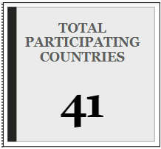
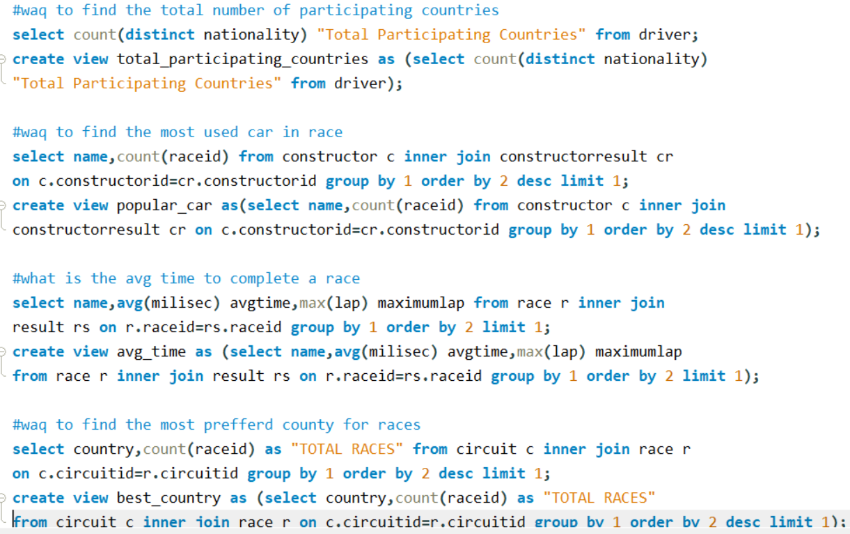
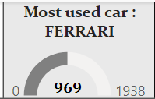
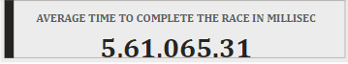
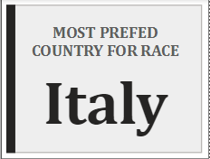

Slide 28
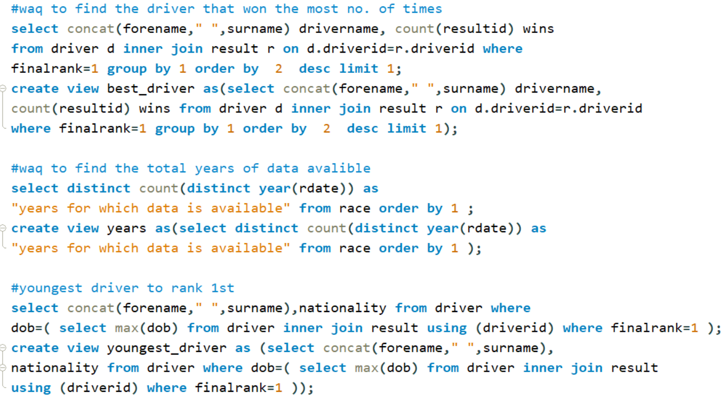
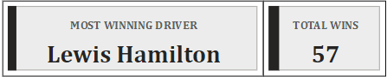
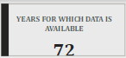
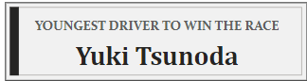

Slide 29
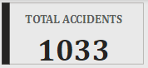
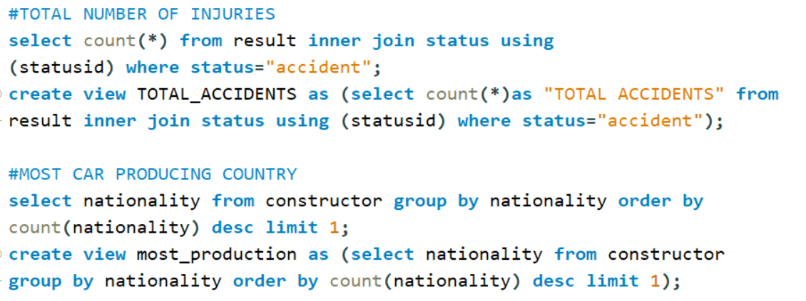
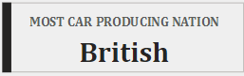

Slide 30
SUMMARY
IN THE FORMULA 1 RACING 41 COUNTRIES PARTICIPATE AND IT HAS BEEN GOING ON SINCE 1950. WHICH INDACTES THAT THIS IS A HIGHLY LOVED GAME
FARRARI IS THE MOST USED CAR BUT FROM ABOVE WE KNOW THAT ITS NOT THE FASTEST HENCE WE CAN SAY SPEED IS NOT THE ONLY THING THAT SHOULD BE GOOD THERE ARE OTHER FACTORS TOO LIKE FULE EFFICIENCY , HANDLING , COST ETC
ITALY IS THE MOST PREFFED COUNTRY FOR THE RACE THIS MAY BE CAUSE THE PEOPLE THERE ARE MORE ENTHUSIESTIC ABOUT IT
A LOT OF ACCIDENTS HAPPEN DURING THE RACE SO IT IS ADVICED TO KEEP SAFETY IN CHECK AND HAVE MEDICAL STAFF AT THE VENUE
CARS FROM BRITAIN ARE MOST SOLD IN THE FOREIGN COUNTRIES . THIS SHOWS THAT CARS THERE ARE OF GOOD QUALITY AND THAT BRITAIN HAS GOOD RELATIONSHIP WITH OTHER COUNTRIES

Slide 31
DASHBOARD

Slide 32
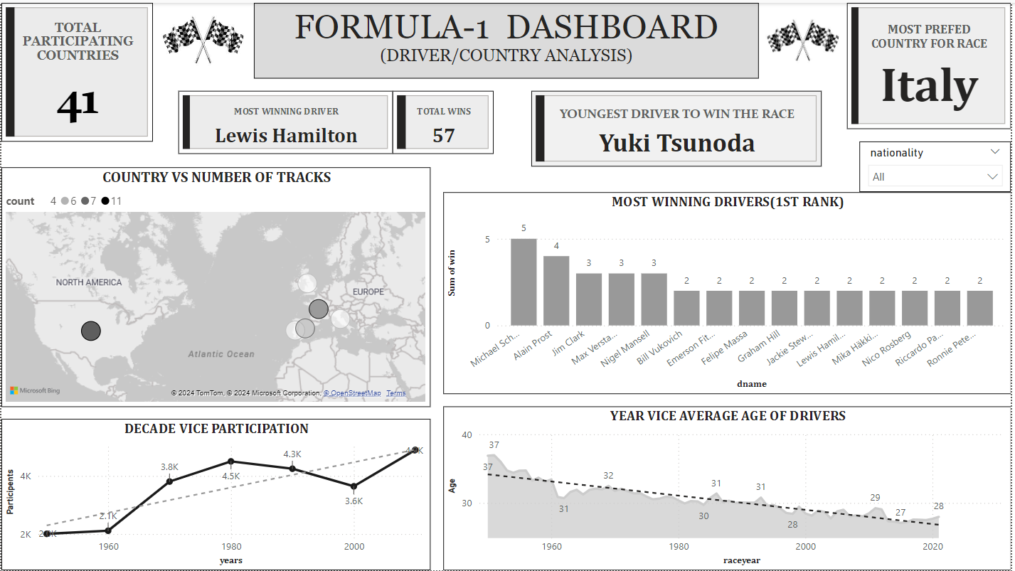

Slide 33
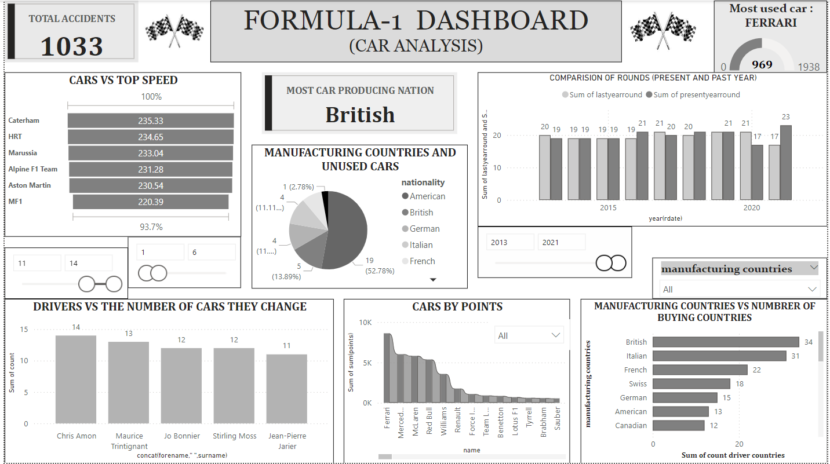

Slide 34
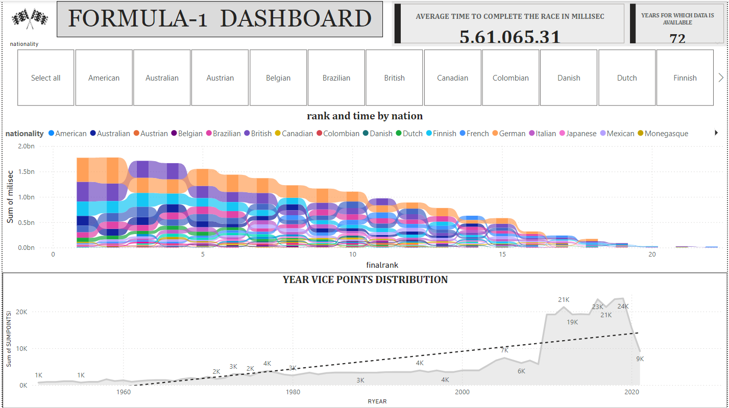

Slide 35
EXCEL STATISTICS

Slide 36
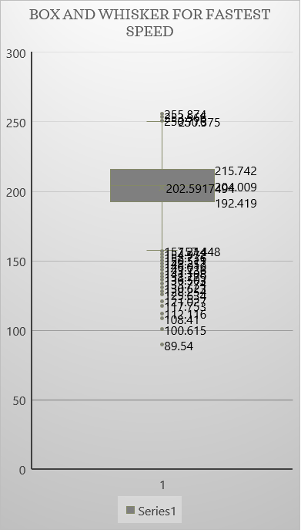
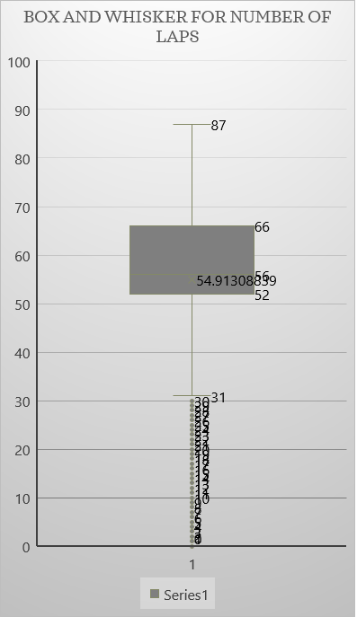
BOX AND WHISKER
FASTEST SPEED :
AS A PARTICIPANT WE MUST KEEP AN EYE ON THE SPEED FOR GETTING THE DESIRED RANK. WE CAN SEE THE MAXIMUM SPEED EVER RECORDED WAS 255.8 HOWEVER THE MEDIAN IS 202.5 . SO HOWEVER ITS IMPORTANT TO SPEED UP BUT KEEPING AN EYE ON THE SAFTY WE CAN CONTROL OUR SPEED ACCORDINGLY
LAPS:
WE CAN SEE THAT THE MAXIMUM LAPS EVER RECORDED WERE 87 SO MANY LAPS CAN BE TIRING AND BORING TO WATCH SO WE SHOULD KEEP THE LAPS IN A SAFE RANGE OF AROUND 54

Slide 37
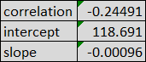
LINEAR REGRESSION
THIS CHAT SHOWS THE RELATIONSHIP BETWEEN TIME AND LAPS . THIS INDICATES THAT THE DRIVERS GENRALLY INCREASE THEIR SPEED IN ONCE IN 15 LAPS

Slide 38
FORECASTING
THIS SHOWS THE YEARS AND THE NUMBER OF PARTICIPANT . ACCORDING TO THE GRAPH THE NUMBER OF PARTICIPANTS ARE DECREASING RAPIDLY. TO CONTROL THAT WE MUST ADD SOME NEW THINGS TO ENCOURAGE PARTICIPATION

Slide 39


DISCRIPTIVE STATISTICS
DISRIPTIVE STATISTICS ON FASTEST LAP SPEED BY THIS WE CAN ANALYSE THE MEADIAN , MODE , MEAN ,STANDARD DEVIATION ,VARIANCE,SKEWNESS ETC

Slide 40

HISTOGRAM
WHAT IS FASTEST LAP SPEED ATTAINED MOST NUMBER OF TIMES ?
WE CAN SEE FROM THE GRAPH THAT THE FASTEST LAP SPEED BETWEEN (253 AND 257) HASN’T BEEN ATTAINED MANY TIMES .HENCE WE SHOULD FOCUS ON MAKING OUR ENGINES POWERFUL SO THE PARTICIPANTS RATE OF WINNING THE RACE INCREASES

Slide 41
RECOMMENDATIONS
AS WE OBSERVED THAT YOUNG PEOPLE ARE MORE INTRESTED IN THE RACE WE SHOUILD ADVERTISE THE GAME ACCTIVELY ON VARIOUS SOCIAL MEDIA PLATFROMS LIKE INSTARAM USED BY YOUNG PEOPLE
AS A PARTICIPANT ATTAINING THE TOP SPEED IS NOT ESSENTIAL AS LONG AS YOUR TECHNIQUES ARE GOOD
SAFETY PRECAUTIONS MUST BE TAKEN AS ACCIDENTS ARE VERY COMMON EVERY YEAR 14 OR MORE PEOPLE GET INJURED
WE SHOULD BOOST UP OUR SPEED ONCE IN EVERY 15 LAPS TO SAY IN A GOOD POSITION IN THE RACE
FARRARI SALES IN THE RACE ARE NEARLY HALF SO AS A RIVAL COMPANY WE SHOULD MONITOR THEIR PRODUCTIONS STYLE FOR THE INCREASE IN OUR SALES
WE MUST KEEP DISTRIBUTING MORE POINTS TO KEEP THE RACE INTRESTING BUT NOT SOO MUCH THAT THE PEOPLE START BELIVING ITS FAKE WHICH COULD DRASTICALY AFFECT THE PEOPLE’S INTREST

Slide 42
THANK YOU

